Slide 1

Single Image Super Resolution Using Deep Convolutional
Neural Networks
G Sairam B141533
K Vijayakumar B141521
K Vamshi B141858
Under the esteemed guidance of
Mr. K Ravikanth
Department of C.S.E.
Rajiv Gandhi University of Knowledge Technologies,
Basar,Nirmal Dt.
SISR using DCNN
February 15,2020
1/15

Slide 2
Contents
Introduction
Literature review
Problem statement
Existing system
Proposed system
Datasets
Applications
Future scope
References
SISR using DCNN
February 15,2020
2/15

Slide 3
Introduction
Single image super resolution (SISR) means generating a high resolution image given a low resolution image.
SISR is widely used in Computer vision applications like medical imaging and security systems.
We will use a super resolution method based on very deep convolutional networks with nearly 20 weight layers.
SISR using DCNN
February 15,2020
3/15

Slide 4
Literature review
Authors | Title of the paper | Key features
Chao Dong,Chen Change Loy,Kaiming He | Image Super-Resolution Using Deep Convolutional Networks | Super-resolution, Convolutional neural networks
Jiwon Kim, Jung Kwon Lee and Kyoung Mu Lee | Accurate Image Super-Resolution Using Very Deep Convolutional Networks | Super-resolution, very deep convolutional neural networks
SISR using DCNN
February 15,2020
4/15

Slide 5
Problem Statement
The main objective is to implement a very deep convolutional network to maximize convergence speed and to handle multiple scale super resolution problem efficiently.
SISR using DCNN
February 15,2020
5/15

Slide 6
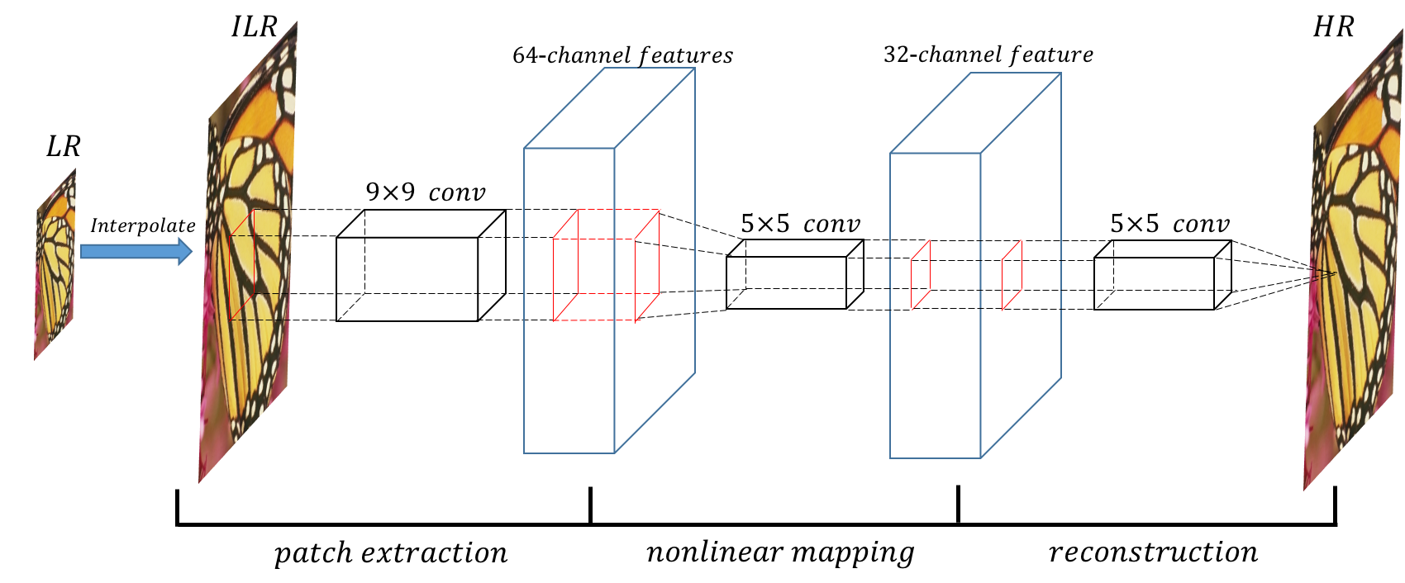
Existing System
SRCNN consists only 3 layers - Patch extraction, non-linear mapping and reconstruction.
It relies on context of small image regions.
Training converges too slowly.
Network only works for a single scale.
SISR using DCNN
February 15,2020
6/15

Slide 7


Proposal System
The network takes an interpolated low-resolution(ILR) image as input.
The image will be passed through pair of Convolutional and non linear activation(ReLu) layers repeatedly to predict residual image.
Each convolutional layer consists of 64 filters of 3x3 size.
The addition of ILR and the residual images gives the desired high resolution image.
LR
ILR
HR
SISR using DCNN
February 15,2020
7/15

Slide 8
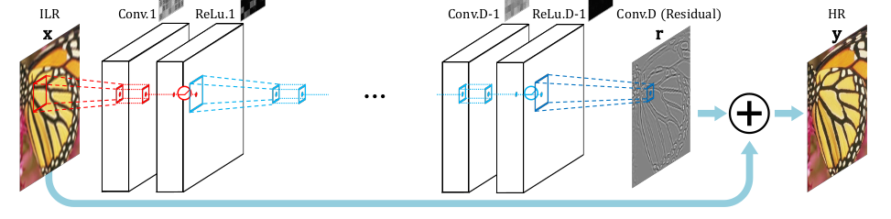
Architecture
SISR using DCNN
February 15,2020
8/15

Slide 9
Proposal System
To improve network performance:
Residual Learning
Zero Padding
High Learning Rates for Deep Networks
Adjustable Gradient Clipping
Multi Scale
SISR using DCNN
February 15,2020
9/15

Slide 10
Datasets
For training :
J. Yang et al. Dataset
Berkeley Segmentation dataset
For testing :
Set 5 Dataset
Set 14 Dataset
Urban100 – A dataset of urban images
BSD100 – Berkeley Segmentation dataset
SISR using DCNN
February 15,2020
10/15

Slide 11
Applications
Satellite image processing
Medical image processing
Microscopy image processing
Astrological studies
Mutlimedia industry and Video Enhancement
Security Systems
SISR using DCNN
February 15,2020
11/15

Slide 12
Future Scope
Super Resolution is still challenging to improve finite texture of the low resolution images. Latest deep learning techniques such as Generative adversarial networks can be used to solve those issues.
SISR using DCNN
February 15,2020
12/15

Slide 13
References
C. Dong, C. C. Loy, K. He, and X. Tang. Image super-resolution using deep convolutional networks. TPAMI, 2015.
C. G. Marco Bevilacqua, Aline Roumy and M.-L. A.Morel. Low-complexity single-image super-resolution based on nonnegative neighbor embedding. In BMVC, 2012.
Jiwon Kim, Jung Kwon Lee and Kyoung Mu Lee. Accurate Image Super-Resolution Using Very Deep Convolutional Networks,2016.
SISR using DCNN
February 15,2020
13/15

Slide 14
Thank You
SISR using DCNN
February 15,2020
14/15

Slide 15
Any Queries?
SISR using DCNN
February 15,2020
15/15

